Slide 1
Quick guide - Sender XC

Slide 2
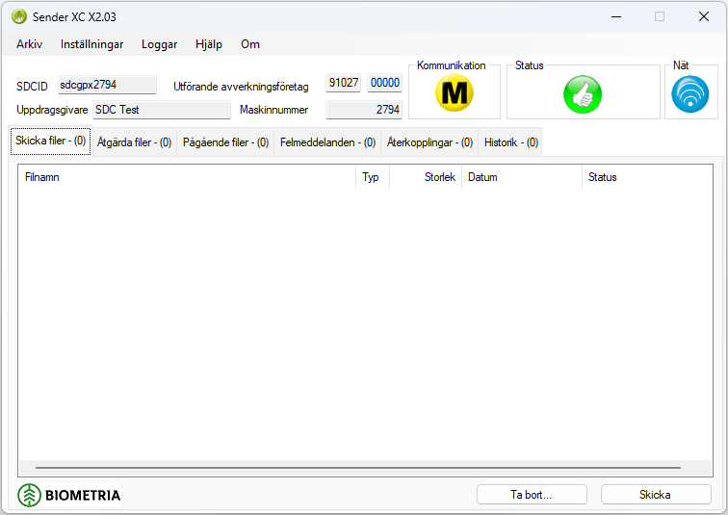
Quick guide - Sender XC
Basic settings must
be filled in and file
paths selected
before use
Files that needs to
be supplemented
Files in processing
for transmission
Error messages caused by format error in StanForDfile(s) sent to Biometria
Error messages caused by mismatch between ”produktionsunderlag” and StanForDfile (s) sent to Biometria
Symbols for Automatic or Manual communication
Symbol for network connection
Basic settings
File(s) ready to be
sent to Biometria
Status of transmission
In case of manual communication: Select the file(s) you want to send and click the button ”Skicka” and the file(s) will be transmitted to Biometria.
Files that has been sent to or received from Biometria
In case of manual communication: Files not to be sent to Biometria; select the file(s) you want to remove and click the button ”Ta bort”
In case of automatic
communication:
As soon as the files
are created they will
be sent to Biometria

Slide 3








Quick guide - Sender XC
Automatic mode for file transmission
Sender XC is connected with the network
Manual mode for file transmission
Sender XC isn´t connected with the network. No transmission or receiving of files can be done
OK
File needs to be supplemented before transmission
New file(s) can be transmitted
File transfer in progress (Don´t close Sender XC!)

Slide 4
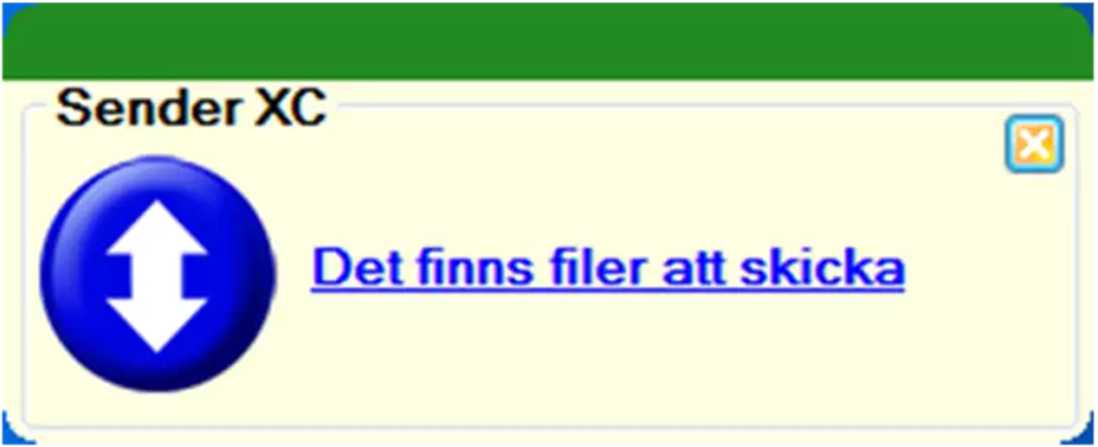
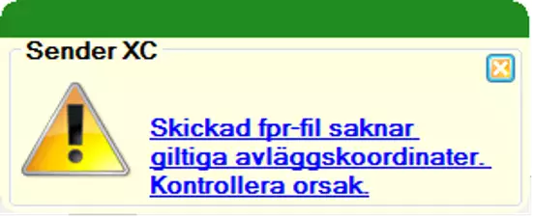
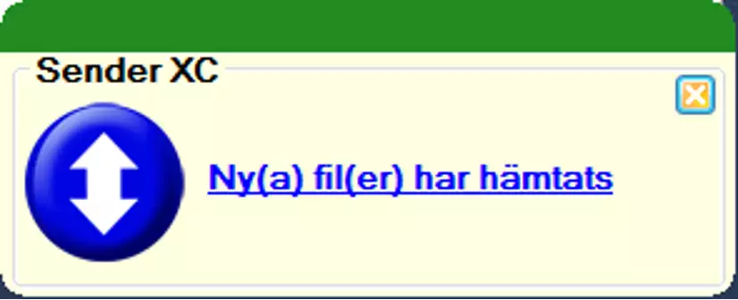
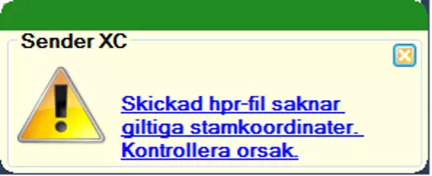
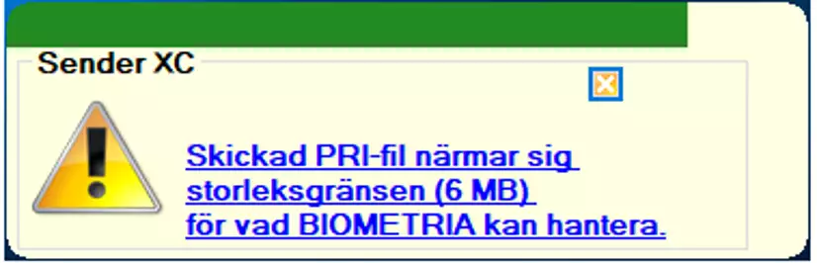
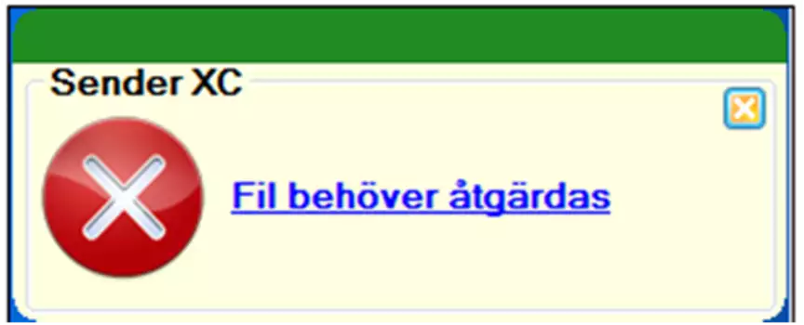
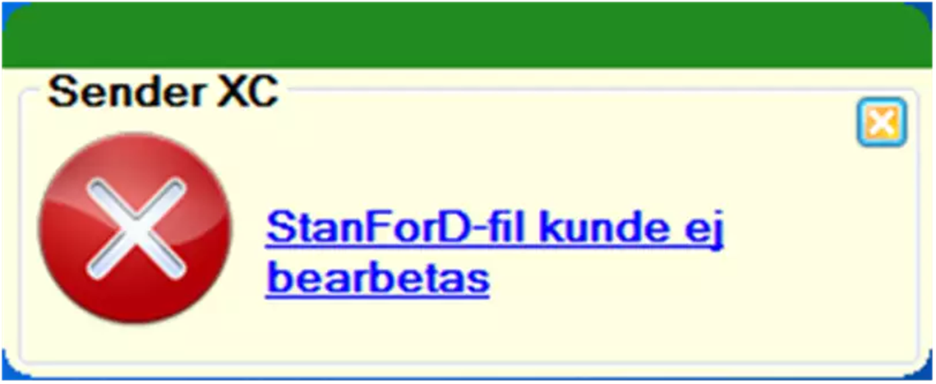
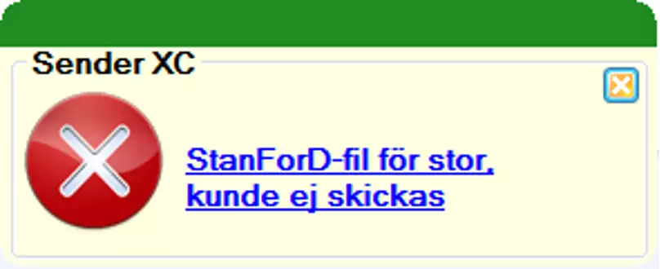
Quick guide - Sender XC
New file(s) can be sent
Click the link to see file(s) ready to send
Information that Location Coordinates are missing. The message disappear when you click the link
New file(s) can be recieved
Click the link to see file(s) ready to download
Information that stemcoordinates are missing. The message disappear when you click the link
A file is almost to big for Biometria to handle. It is recomended to make a partial conclusion at the object
File needs to be supplemented
Click the link to adjust information
Biometria can not read the file
Click the link for more information
File is to big to send
Contact your outsourcer
For more information Contact Biometrias support: support.viol3@biometria.se

